Slide 1
Safe operations – good business?
Martin Atterhall

Slide 2
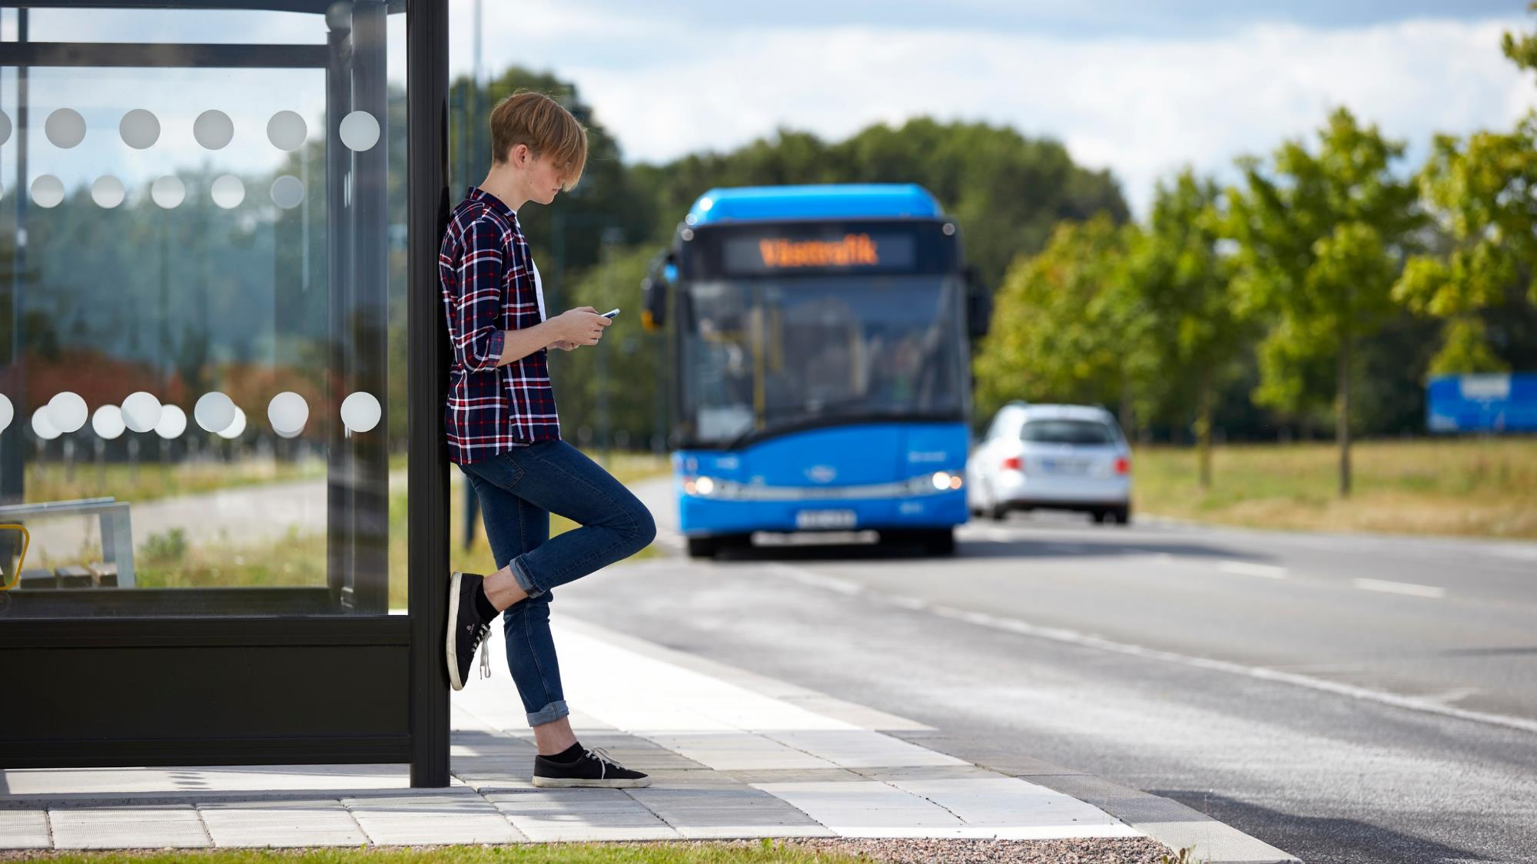
Nobina - The Leading nordic PT operator
700
500
350
2500
300

Slide 3
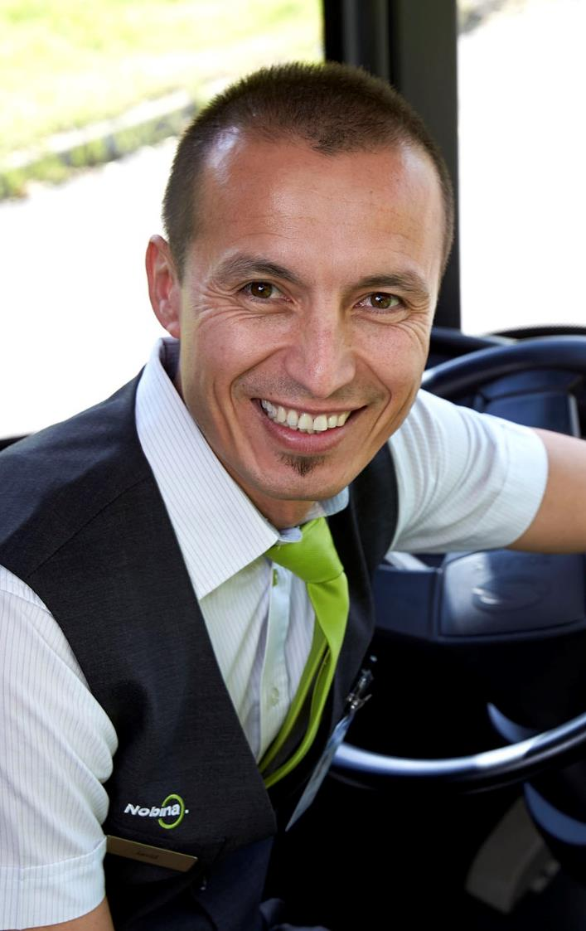
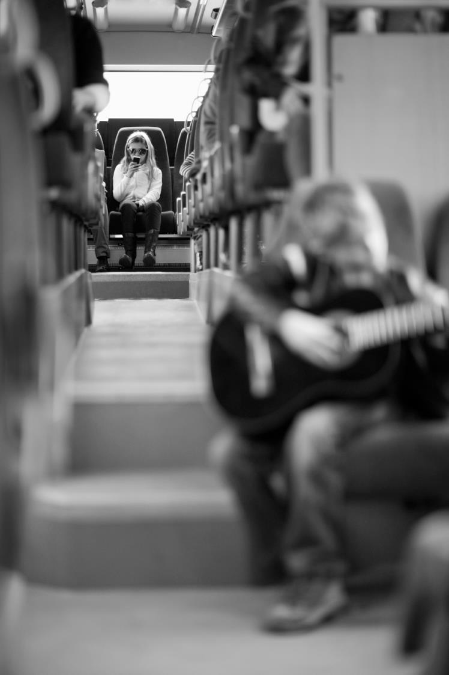
7 200
319 000 000
244 000
11 000

Slide 4
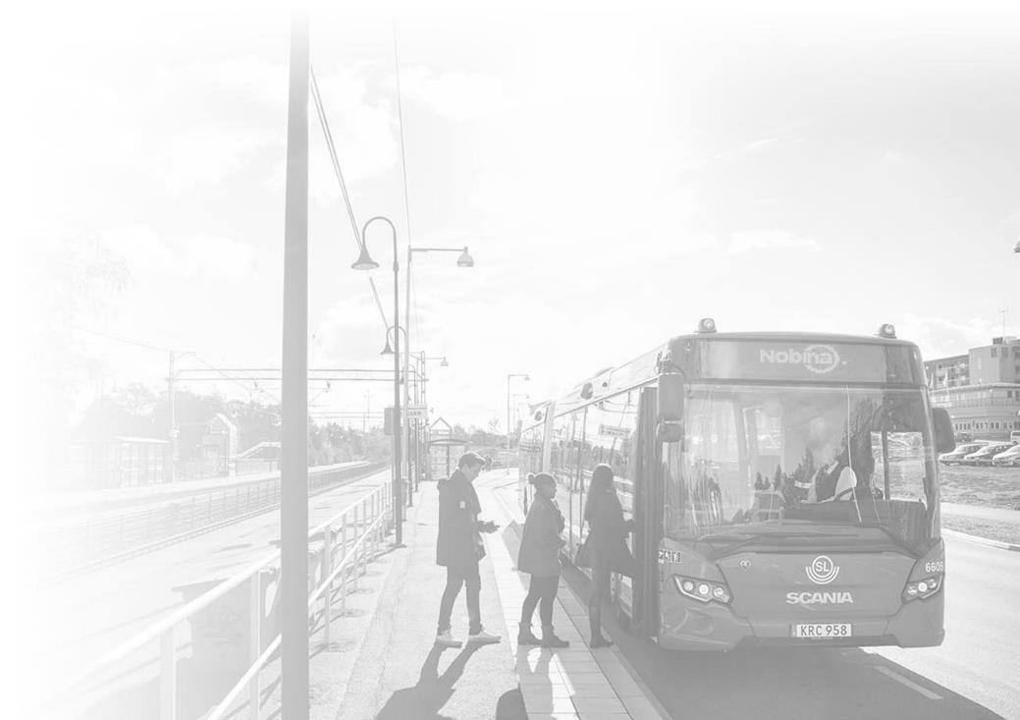
Nordic public bus transport market dynamics
Clients (PTA’s)
Operators (PTO’s)
Local governments
Public subsidies
Contract-based payment
8-10 yrs
Ticket revenue
Bus services
POLITICAL AGENDA
Passengers
Passengers
Notes:
Cost increases in short term needs to be covered by increased subsidies, passenger revenue can not be expected to cover cost increase for electrification.
Not increasing subsidies would force reduced supply
In the PT case that means less passengers and revenue, and then we’re running down the negative spiral
This is where we wan’t to contribute, by participating in minimizing the need for extra subsidies

Slide 5
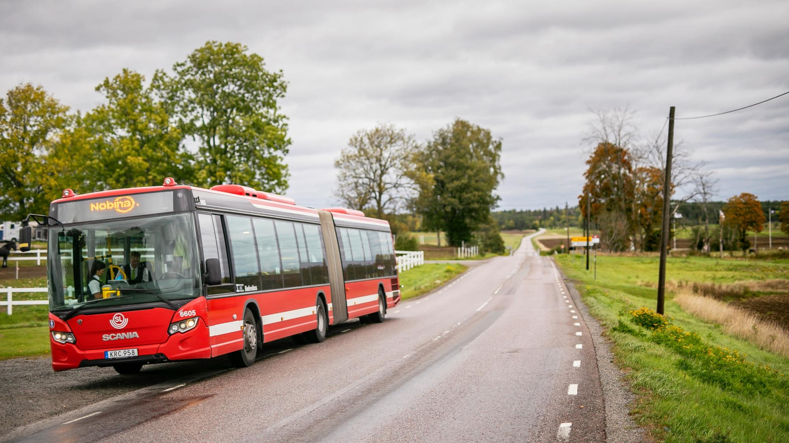
Bus – the safest road transport
Distribution of lethal accidents in traffic [Sweden 2011-2016]
Notes:
Looking at statistics - bus is really the supreme road transportation

Slide 7
Safe operations start with people
… and processes

Slide 8
Management challenge
Provide prerequisites for all employees to make correct decisions
Strategies
Competence & training
Values
Processes & routines
Resources

Slide 9
Route
Timetable
Driver schedule
Infra-structure
Vehicle
Driver

Slide 10
Route
Timetable
Driver schedule
Infra-structure
Vehicle
Driver

Slide 11
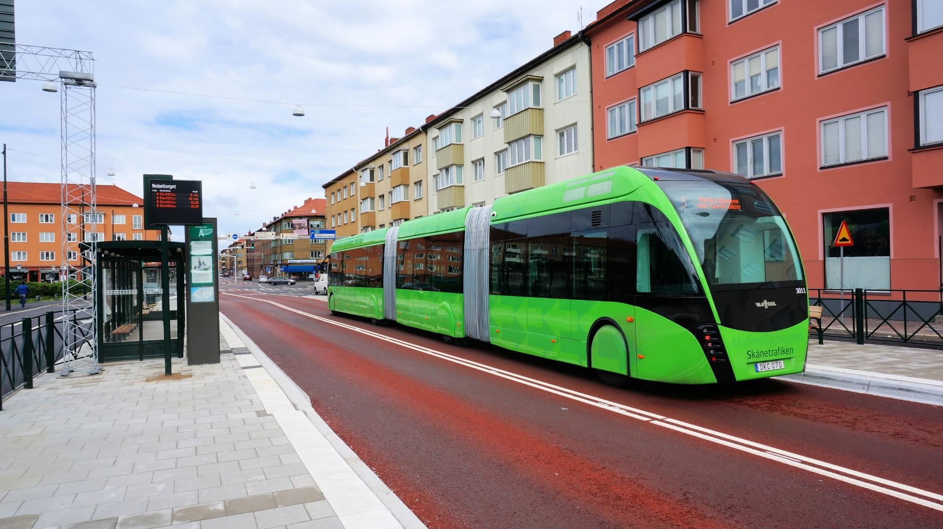
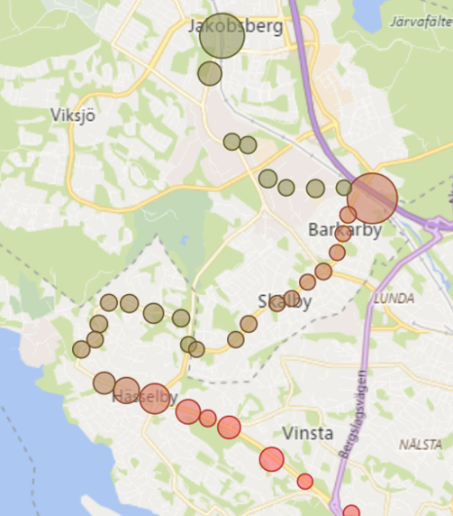
Planning and infrastructure

Slide 12
Route
Timetable
Driver schedule
Infra-structure
Vehicle
Driver

Slide 13
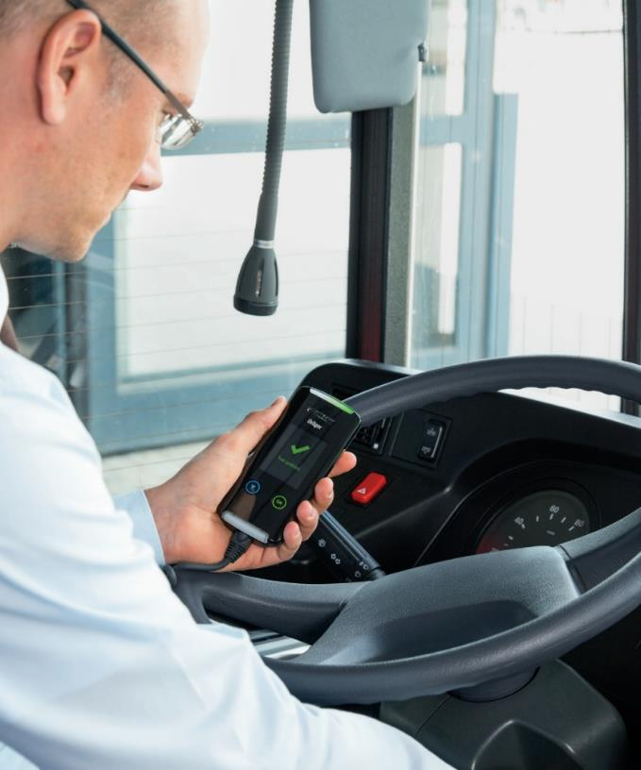
Alcolock
100% of the fleet
Real-time alert if activated
Notes:
Keywords:
Alcolock
Real-time alert at dispatch
Passenger safety
Driver health and abscense

Slide 14
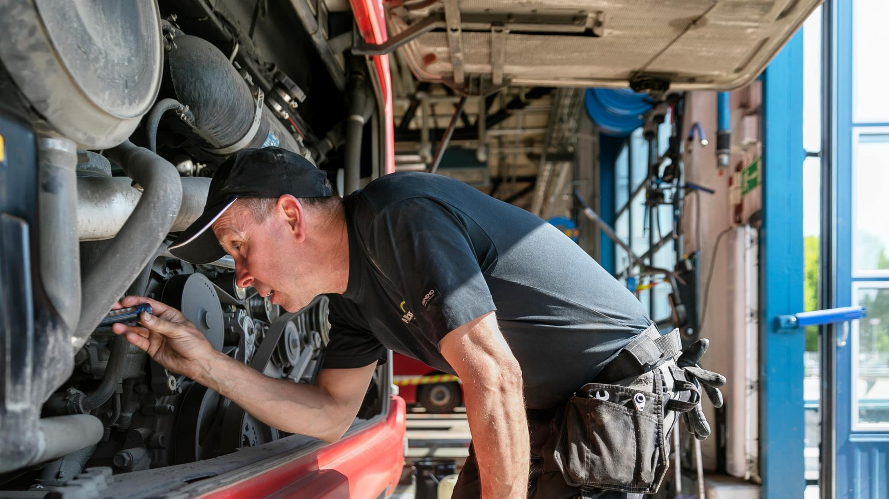
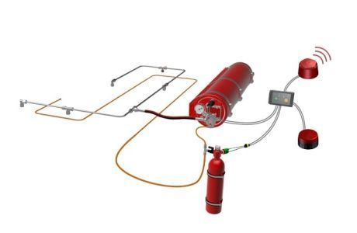
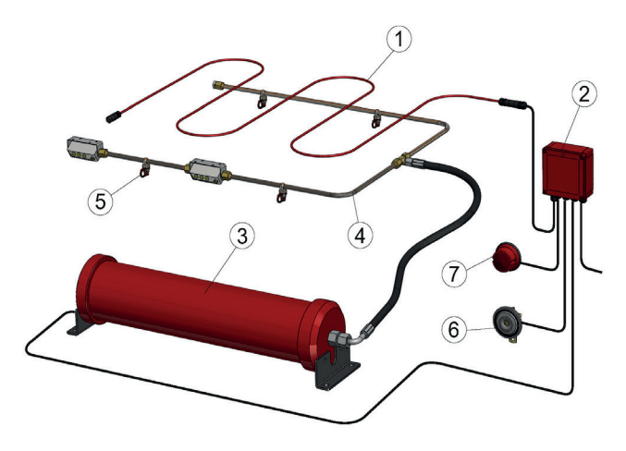
Fire prevention
Notes:
Keywords:
- Maintenance processes and routines
Automatic fire extinguishers
Fire incidents
Yearly technical inspections

Slide 15
Route
Timetable
Driver schedule
Infra-structure
Vehicle
Driver

Slide 16
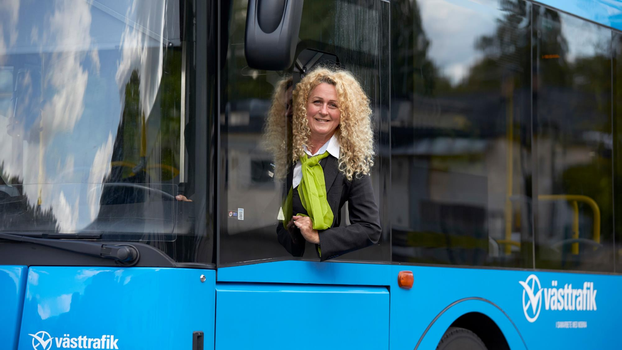
Training
Ecodriving
Certification
Service to customer
Driver management
Decentralised – Group Managers
Feedback and support structure
Personal interaction
Notes:
Keywords
Driver training
Management
Absence
Availability
Skills and motivation

Slide 17
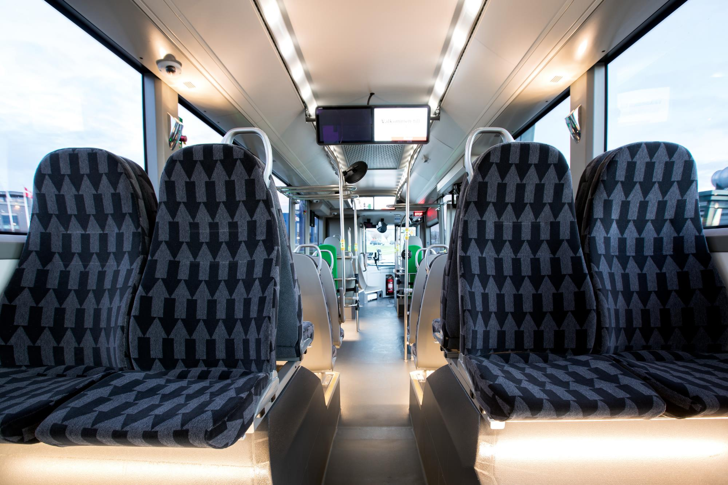
Conclusions
Culture is the main driver of safety – not technology
Building your business-case often requires a wide perspective approach
Reverse calculations matters – can you afford continuing being unsafe?
Safe does not necessarily mean inefficient
Safety does not necessarily come at a cost – at least not over time

Slide 18
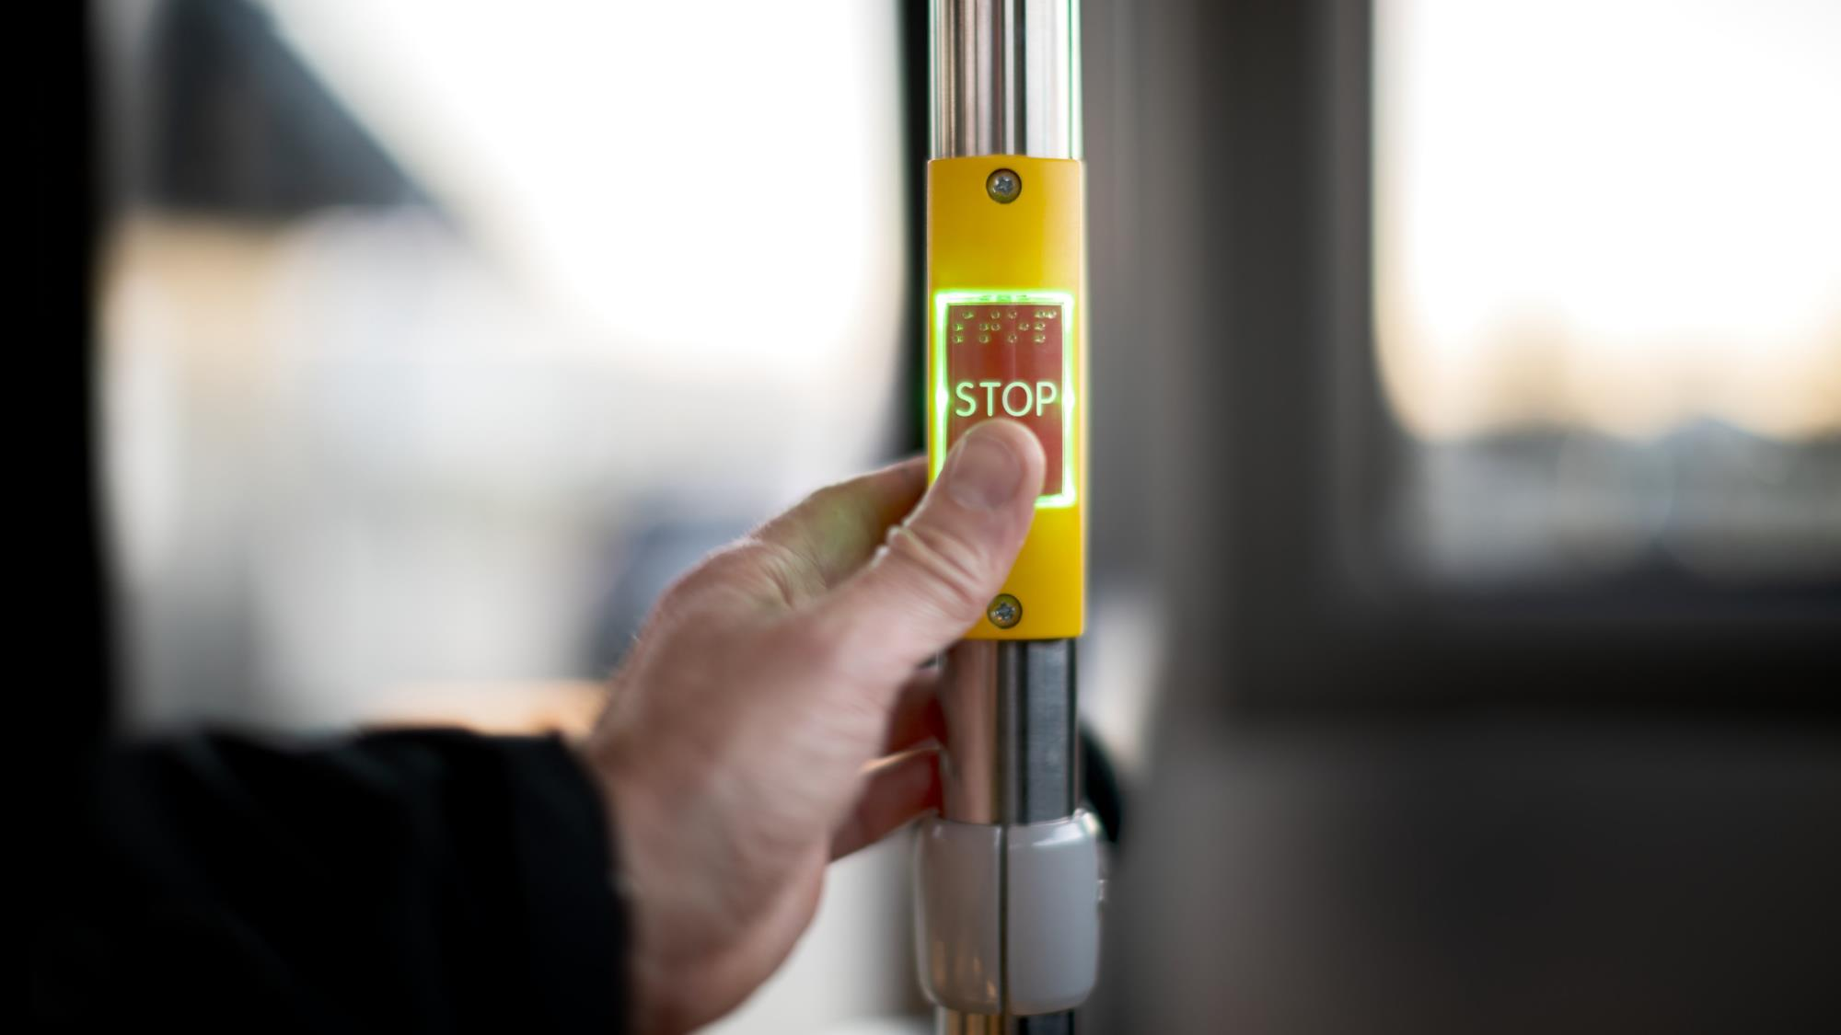
Thank you for your attention!

